Slide 1


BLOCK-CHAIN TECHNOLOGY

Slide 2

What is Blockchain?
A growing list of records, called blocks, that are linked using cryptography.
Each block contains a cryptographic hash of the previous block, a timestamp, and transaction data (generally represented as a Merkle tree).
By design, a blockchain is resistant to modification of its data.
This is because once recorded, the data in any given block cannot be altered retroactively without alteration of all subsequent blocks.

Slide 3
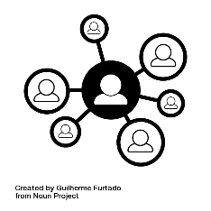
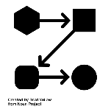

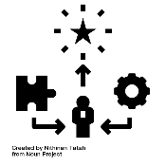
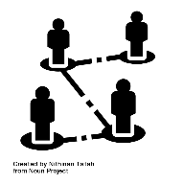

Ethereum
Banking for Everyone
Censorship Resistant
Gain access to financial services with just an internet connection
No government holds any power over Ethereum making it decentralized and accessible to everyone
Private Internet Connection
Commerce Guarantees
Doesn’t require much details providing privacy
Customers have a secure, built-in guarantee that funds will only change hands if you provide what was agreed.
Peer-to-Peer Connection
Increased Compatibility
Allows sending money or making mutual agreements directly with someone without any 3rd party interference
Ethereum products are enhanced time to time for businesses to build upon each other’s success
Notes:
https://www.voguebusiness.com/consumers/luxury-growth-in-2019-bain-china-brazil-mexico

Slide 4
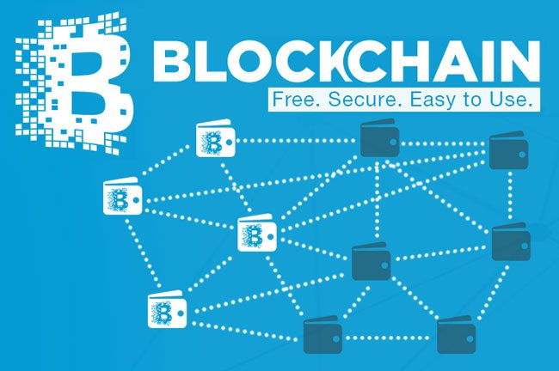
Algorithms and Techniques
Blockchain technology is a combination of technologies applied in various new ways. It is built on a platform using protocols, it is on a peer-to-peer-network that is a system of record and uses private key cryptography for identity. An algorithm is part of a protocol.
Bitcoin is a cryptocurrency that uses a Consensus network algorithm called Proof-of- Work. Bitcoin was the first release of a new electronic cash system that uses a peer-to-peer network to prevent double spending and validate transactions. It is completely decentralized, without any central authority.

Slide 5
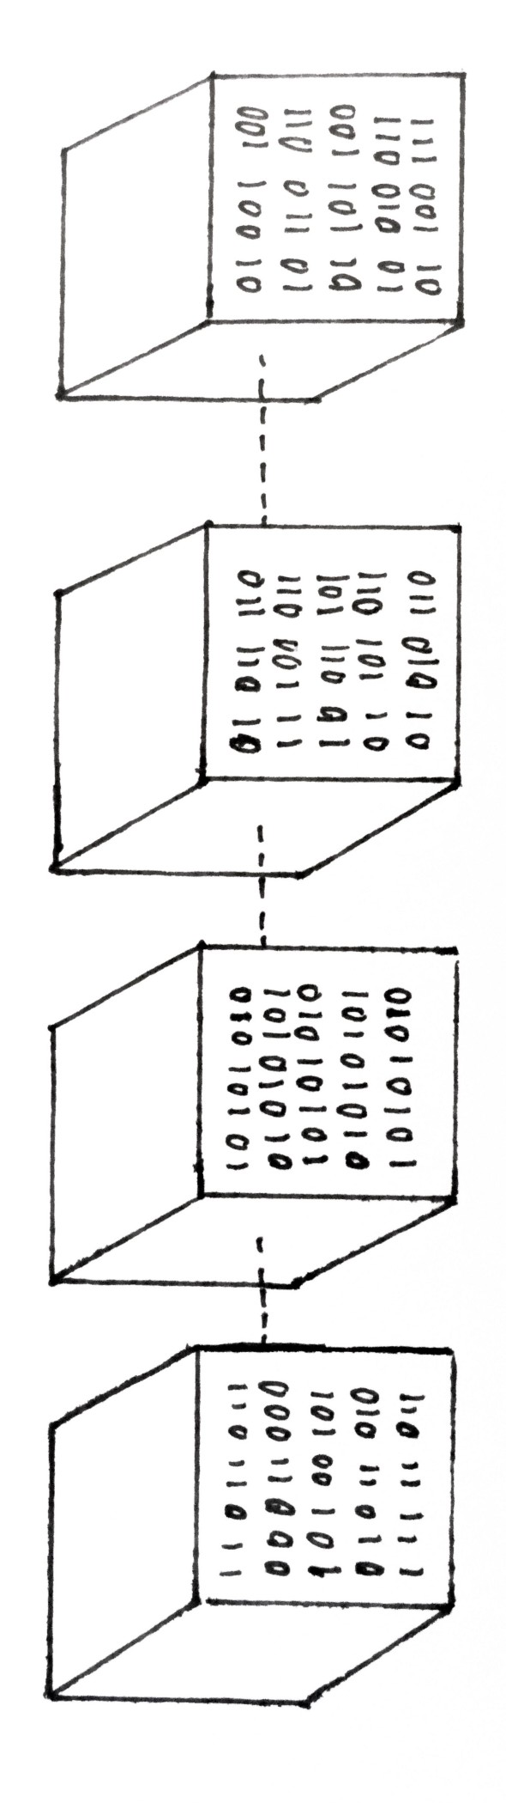
Trust Essentials
Blockchain technology has given rise to a new platform for business relationships that combines ease of use, low cost and high security.
Four different trust architectures:
Peer-to-peer trust
Leviathan trust, which is institutional and involves contracts
Intermediary trust, like PayPal or credit cards that make a transaction work
Distributed trust, which is what blockchain enables — an emergent trust in the system without any individuals in the system trusting each other
Blockchain shifts trust in people and institutions to trust in technology
Ethereum is an interesting example of how trust is working.

Slide 6
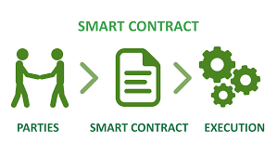
What are smart contracts on blockchain?
Smart contracts are lines of code that are stored on a blockchain and automatically execute when predetermined terms and conditions are met.
Streamline this complex process that involves several intermediaries because of a lack of trust among participants in the transaction.
With your identity stored on a blockchain, lenders can quickly make a decision about credit.
Then, a smart contract would be created between your bank, the dealer and the lender so that once the funds have been released to the dealer, the lender will hold the car’s title and repayment will be initiated based on the agreed terms.
What do smart contracts do?

Slide 7
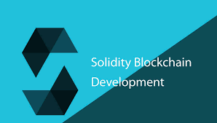
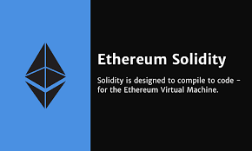
Solidity
Solidity is a high-level and contract-oriented language used for writing smart contracts.
Developed by the core contributors of the Ethereum Blockchain Platform.
It is used for designing and implementing smart contracts within the Ethereum Virtual Machine and other blockchain development platforms.

Slide 8
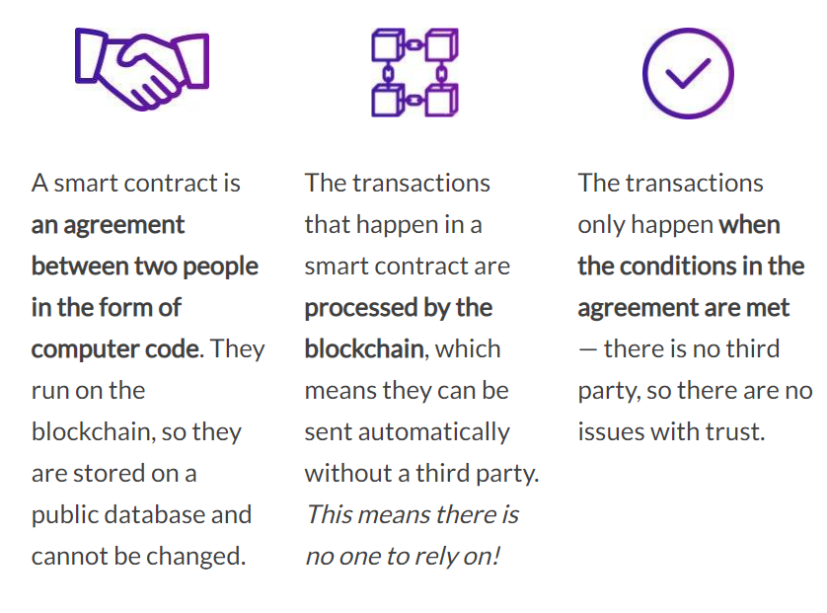
How do smart contracts work?
Smart contracts work by following simple “if/when…then…” statements that are written into code on a blockchain.
A network of computers executes the actions (releasing funds to the appropriate parties; registering a vehicle; sending notifications; issuing a ticket) when predetermined conditions have been met and verified.
The blockchain is then updated when the transaction is completed.

Slide 9
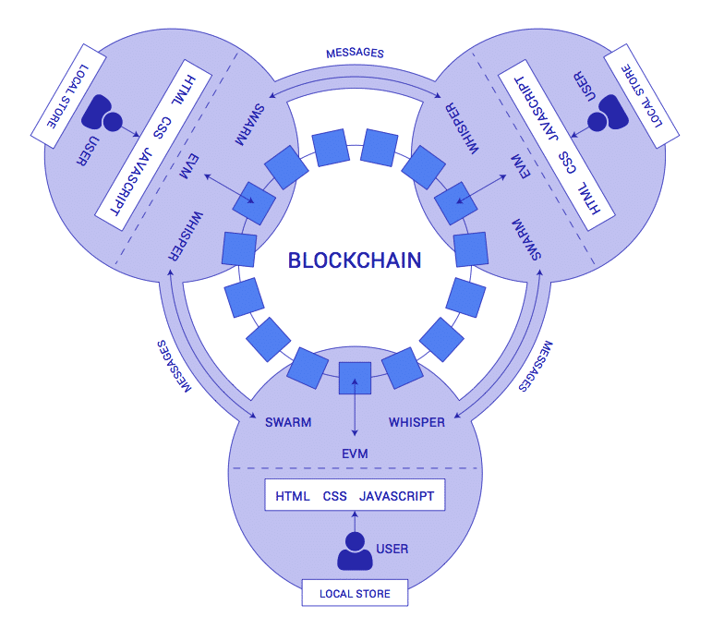
Decentralized Applications
(dApps)
dApps are digital applications that exist and run on a blockchain or P2P network of computers, and are outside the purview and control of a single authority.
In the context of cryptocurrencies, dApps run on a blockchain network in a public, open source, decentralized environment and are free from control and interference by any single authority.
Bitcoin was arguably the first dApp, enabling anyone in the world to download a bit of open-source code to join a blockchain network and verify transactions using a “mining” algorithm, thereby generating digital currency (cryptocurrency) as a reward.

Slide 10
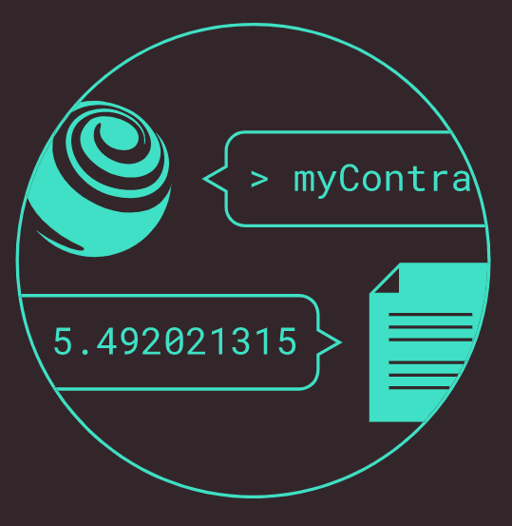
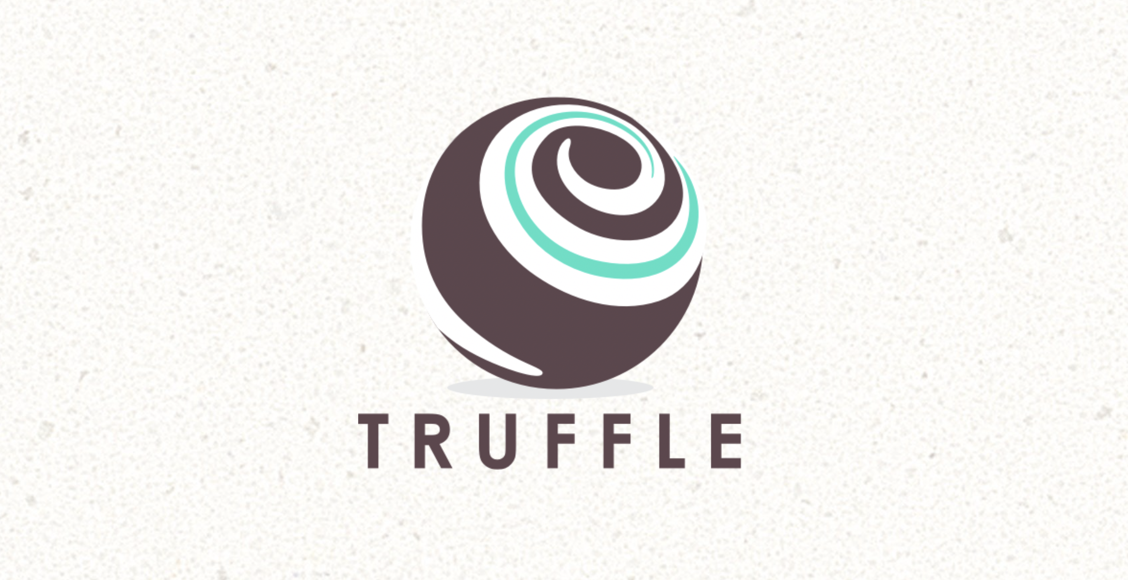
Truffle Development
Truffle is a development environment, testing framework, and asset pipeline all rolled into one.
It is based on Ethereum Blockchain and is designed to facilitate the smooth and seamless development of DApps.
AUTOMATED CONTRACT TESTING
SMART CONTRACT LIFECYCLE MANAGEMENT
POWERFUL INTERACTIVE CONSOLE
SCRIPTABLE DEPLOYMENT & MIGRATIONS
SIMPLE NETWORK MANAGEMENT
EXTERNAL SCRIPT RUNNER

Slide 11
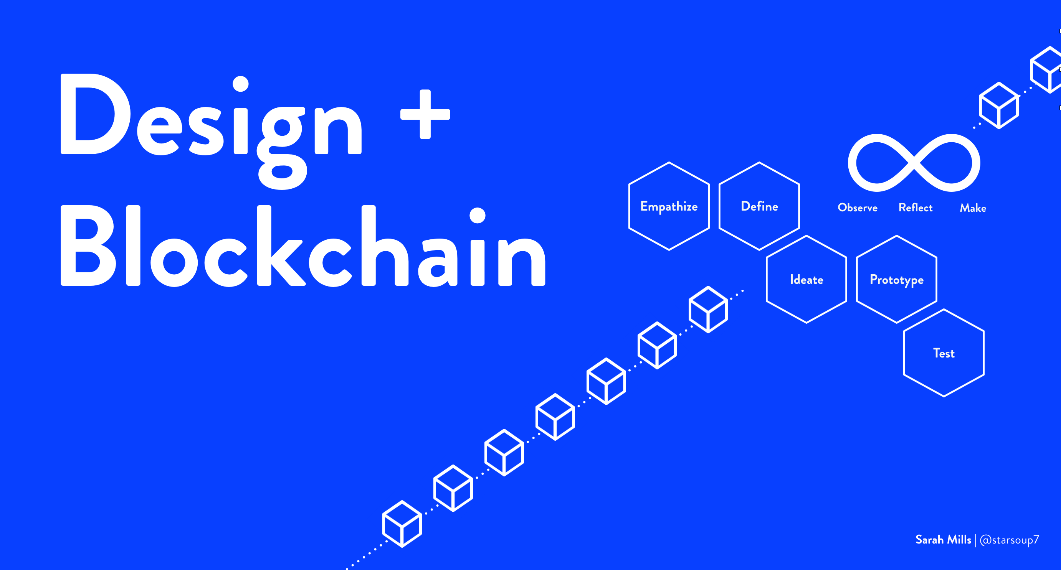
Design Improvments
Ethereum improvement proposal framework, EIP, that manages ongoing improvements to ethereum protocol is a good example of iterative process improvement.
EIP is similar to the request for comments RFC of the Internet Engineering Task Force, IETF.
Minimize the footprint on the immutable ledger in the blockchain.
Manage ownership and lifespan of a smart contract.
Organize related smart contract using interfaces in inheritance for reuse and proper type classification.

Slide 12
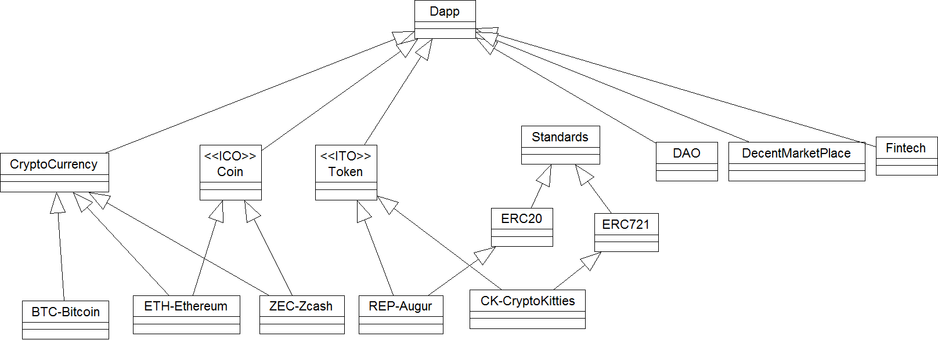
Application Models and
Standards
Coin and Initial Coin Offering use a blockchain to record the distribution of the Coin, receive funds, and specify rules etc.
Token offerings are associated with an asset or utility.
Augur is prediction Dapp that depends on wisdom of crowd and their reports on reputation to predict markets.
Decentralized Autonomous Organization (DAO) is an early innovation in Dapp that was deployed a smart contract-based investment instrument.
Dapp can build a marketplace platform where decentralized unknown (trustless) buyers and sellers can meet and exchange items with the payment and transaction recorded on any of the established blockchain technology such as Bitcoin or Ethereum.
Fintech has great potential for innovative Dapps, ranging from decentralized investment instruments to micropayment channels.

Slide 13
Ethereuem EIPs application level standards in ERCs:
ERC20, ERC 721
EIP is an approach to process improvement in
Ethereum ecosystem.
EIP or Ethereum Improvement Protocol is a means to
manage the protocol specification, improvements,
updates, client APIs and contract standards.
ERC 20 specifies set of rules
that allows a token to
interact with each other,
exchanged with each other,
and transact on the
Ethereum network.
ERC20 is a fungible token.
ERC 721: CryptoKitties
The non-fungible token
concept was brought to
prominence by a Dapp
Cryptokitties.
It is an Ethereum ERC 721.

Slide 14

Popular Permissioned Block Chain Platforms
Decentralised
Let’s one build permissioned blockchain-based dApps
Promotes privacy compared to Ethereum
Consensus protocols supported : IBFT, QuorumChain, Raft
Supports smart contracts, network permissioning & privacy
Allows building own permissioned Block Chain-based apps
Transaction endorsement
Advanced membership features
Quorum
Hyperledger Fabric 1.0
Parity
MultiChain
Popular node software
Consensus protocols supported : Aura & Tendermint
Provides lesser features than Quorum
Features dedicated to MultiChain : permissions agreements, data streams & assets
Doesn’t support smart contracts
Round-Robin validation consensus
Notes:
https://www.voguebusiness.com/consumers/luxury-growth-in-2019-bain-china-brazil-mexico

Slide 15
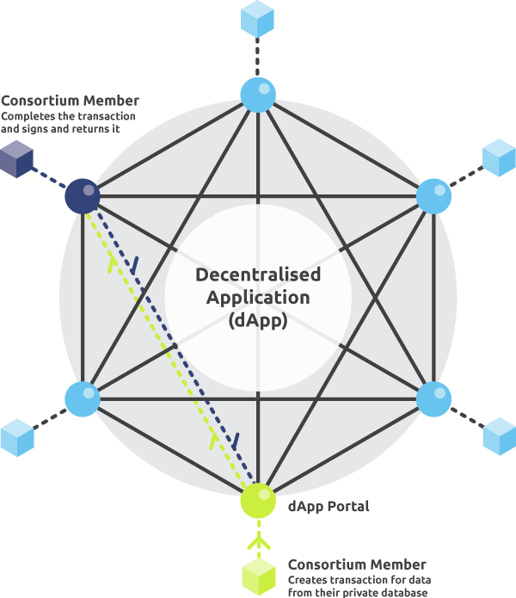
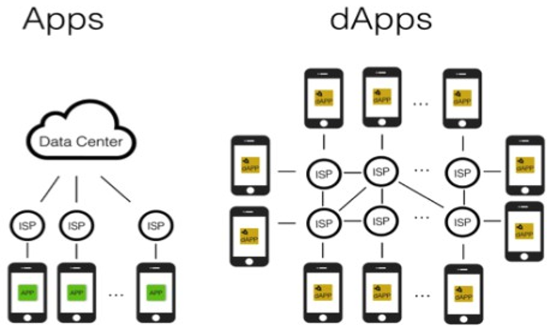
Decentralised Applications Platforms
Decentralised Applications or dApps run above a blockchain, P2P network that is simulation of an OS.
dApps create a unique open-source software environment which is secure and resilient at the same time allowing customers worldwide to create online tools easily.
No node instructs the other as to what to do?
Most software applications rely on a single data center for information unlike dApps that are decentralized cutting down the need of having a single server.

Slide 16
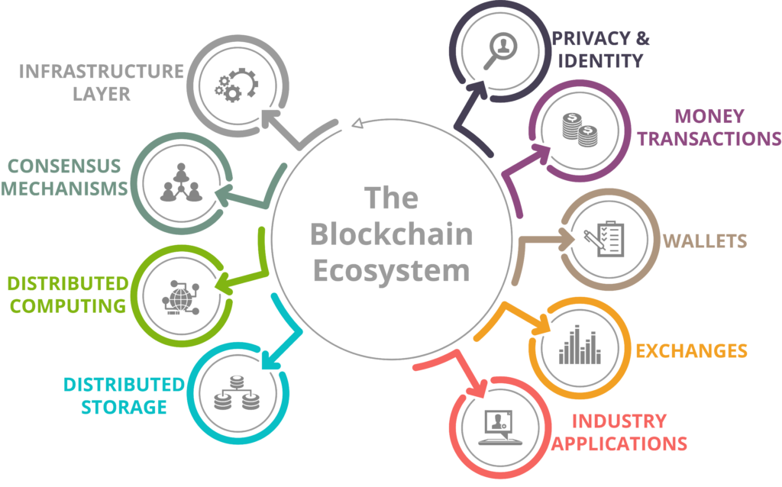
Challenges and Solutions
Implementation of a Lightning network that adds an extra layer to facilitate faster transactions
Sharding of nodes to increases transaction speeds. Nodes would be responsible for transaction within themselves.
Systems must be equipped with enough resources to facilitate decentralisation without tradeoffs.
Better educational campaigns to make all this knowledge more accessible to solve the lack of awareness challenge.
Development of more efficient consensus algorithms to reduce energy taxing with the decentralized architectures
Technical Scalabilty
Improvements in transaction speeds
Decentralisation
Lack of awareness and understanding
Energy consumption of decentralised systems

Slide 17
Block Chain Application Development
Interacting with the Bitcoin Block-chain
Setting up Libraries and Accounts
Decentralized Applications
Decentralized applications are a piece of software that communicates with the block chain and manages the state of all network actors.
The interface of the decentralized applications does not look any different than any website or mobile app.
Bitcoin is the bedrock for cryptocurrencies . By spreading operations across a network of computers, block chain allows Bitcoin to operate without the need for a central authority.
This reduces risk and also eliminates many of the processing and transaction fees.
It is actually quite easy using BitcoinLib for cryptocurrency development.
It is compatible with all RPC API’s for Bitcoin Core, Bitcoin, altcoins, and possibly your own cryptocurrency project.

Slide 18
Block Chain Application Development
Creating a Smart Contract
Executing Smart Contract functions
Step 1: Find an open source Solidity contract as a starting point.
Step 2: Define the abstract token contract.
Step 3: Define the abstract store contract.
Step 4: Write test cases for use with TDD.
Step 5: Implement the smart contract code.
Smart contracts get executed by the blockchain nodes, as a result of processing transactions that are submitted by the user.
A blockchain transaction has a designated target smart contract function, a payload that contains input values to the function call, and always signed by the submitter.

Slide 19
Alternatives to Decentralised Solutions & Business Use Cases
Alternatives to be looked at
Centralised transaction systems and databases must be used until and unless there is no need for decentralisation to bring in greater scalability.
Usage of cloud services to rid off the security issues and to help store humongous amounts of data into clouds rather than depending on blockchain system.
Other distributed ledger systems can be explored for better performance.
Business Use Cases
Asset Management – real estate.
Capital Markets – optimization of backend costs.
Decentralized Finance - economic opportunity for global citizens.
Economic opportunity for global citizens - global supply chains, managing trade finance.
Payments and Money – blockchain provides an easy way of handling huge transactions.

